Slide 1




Introduction to Machine Learning
© 2019 Tryolabs

Slide 2

What is Machine Learning?
Introduction to Machine Learning
The subfield of computer science that “gives computers the ability to learn
without being explicitly programmed”.
(Arthur Samuel, 1959)
A computer program is said to learn from experience E with respect to some class of tasks T and performance measure P if its performance at tasks in T, as measured by P, improves with experience E.”
(Tom Mitchell, 1997)
Using data for answering questions Training Predicting

Slide 3
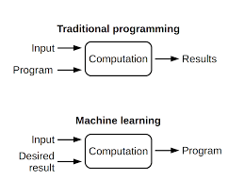

Slide 4
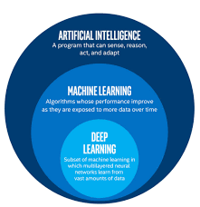

Slide 5
The Big Data Era
Introduction to Machine Learning
Services
Cloud Computing:
Online storage
Infrastructure as a Service
User applications:
Data
Data already available everywhere
Low storage costs: everyone has several GBs for “free”
Hardware more powerful and cheaper than ever before
Devices
Everyone has a computer fully packed with sensors:
GPS
Cameras
Microphones
YouTube
Gmail
Facebook
Twitter
Permanently connected to Internet

Slide 6
Types of Machine Learning Problems
Introduction to Machine Learning
Supervised
Unsupervised
Reinforcement

Slide 7
Types of Machine Learning Problems
Introduction to Machine Learning
Learn through examples of which we know the desired output (what we want to predict).
Supervised
Is this a cat or a dog?
Are these emails spam or not?
Unsupervised
Predict the market value of houses, given the square meters, number of rooms, neighborhood, etc.
Reinforcement

Slide 8
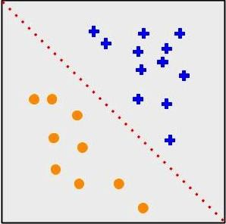
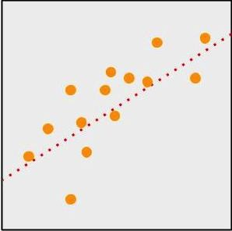
Types of Machine Learning Problems
Introduction to Machine Learning
Supervised
Classification
Output is a discrete variable (e.g., cat/dog)
Unsupervised
Regression
Output is continuous (e.g., price, temperature)
Reinforcement

Slide 9
Types of Machine Learning Problems
Introduction to Machine Learning
Supervised
There is no desired output. Learn something about the data. Latent relationships.
Unsupervised
I have photos and want to put them in 20 groups.
I want to find anomalies in the credit card usage patterns of my customers.
Reinforcement

Slide 10
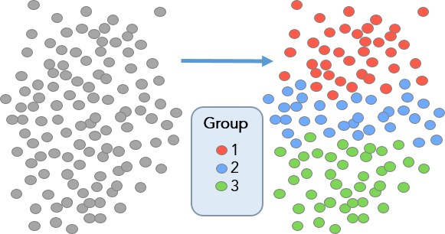
Types of Machine Learning Problems
Introduction to Machine Learning
Supervised
Useful for learning structure in the data (clustering), hidden correlations, reduce dimensionality, etc.
Unsupervised
Reinforcement

Slide 11

Types of Machine Learning Problems
Introduction to Machine Learning
Supervised
An agent interacts with an environment and watches the result of the interaction.
Environment gives feedback via a positive or negative reward signal.
Unsupervised
Reinforcement

Slide 12
Introduction to Machine Learning
Steps to Solve a Machine Learning Problem
Data Gathering
Collect data from various sources
Data Preprocessing
Clean data to have
homogeneity
Feature Engineering
Making your data more useful
Algorithm Selection
& Training
Selecting the right machine learning model
Making Predictions
Evaluate the model

Slide 13
Data Gathering
Introduction to Machine Learning
Might depend on human work
Manual labeling for supervised learning.
Domain knowledge. Maybe even experts.
May come for free, or “sort of”
E.g., Machine Translation.
The more the better: Some algorithms need large amounts of data to be useful (e.g., neural networks).
The quantity and quality of data dictate the model accuracy

Slide 14
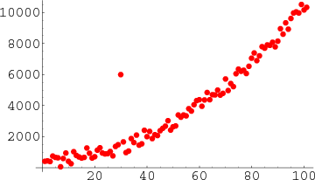
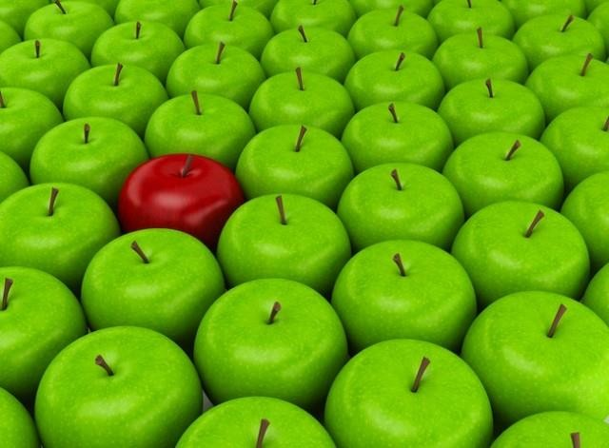
Data Preprocessing
Introduction to Machine Learning
Is there anything wrong with the data?
Missing values
Outliers
Bad encoding (for text)
Wrongly-labeled examples
Biased data
Do I have many more samples of one class than the rest?
Need to fix/remove data?

Slide 15
Feature Engineering
Introduction to Machine Learning
What is a feature?
A feature is an individual measurable property of a phenomenon being observed
Our inputs are represented by a set of features.
To classify spam email, features could be:
Number of words that have been ch4ng3d
like this.
Language of the email (0=English, 1=Spanish)
Number of emojis
Buy ch34p drugs from the ph4rm4cy now :) :) :)
Feature
engineering
(2, 0, 3)

Slide 16
Feature Engineering
Introduction to Machine Learning
Extract more information from existing data, not adding “new” data per-se
Making it more useful
With good features, most algorithms can learn faster It can be an art
Requires thought and knowledge of the data Two steps:
Variable transformation (e.g., dates into weekdays, normalizing)
Feature creation (e.g., n-grams for texts, if word is capitalized to detect names, etc.)

Slide 17
Algorithm Selection & Training
Introduction to Machine Learning
Supervised
Unsupervised
Linear classifier
Naive Bayes
Support Vector Machines (SVM)
Decision Tree
Random Forests
k-Nearest Neighbors
Neural Networks (Deep learning)
PCA
t-SNE
k-means
DBSCAN
Reinforcement
SARSA–λ
Q-Learning

Slide 18




Algorithm Selection & Training
Introduction to Machine Learning
Goal of training: making the correct prediction as often as possible
Incremental improvement:
Predict
Adjust
Use of metrics for evaluating performance and comparing solutions
Hyperparameter tuning: more an art than a science

Slide 19
Summary
Introduction to Machine Learning
Machine Learning is intelligent use of data to answer questions
Enabled by an exponential increase in computing power and data availability
Three big types of problems: supervised, unsupervised, reinforcement
5 steps to every machine learning solution:
Data Gathering
Data Preprocessing
Feature Engineering
Algorithm Selection & Training
Making Predictions

